Slide 1
safetyGraphics
An open source framework for evaluation of clinical trial safety
Links: CRAN | GitHub | Demo

Slide 2
Disclaimers
We are using a cloud-based platform for today’s workshop. Don’t load any of your own data.
safetyGraphics is not Validated or Qualified. Consult with the powers that be (IT, Compliance, etc.) at your organization before using it in your work.
For more info about security, validation and other technical topics see our FAQ

Slide 3
Agenda
Intro To safetyGraphics (20 min – Jeremy/Xiao)
Hello World (10 min – Xiao)
Breakout 1
Loading Custom Data (30 min – Jeremy)
Breakout 2
Chart/App Export (10 min – Jeremy)
-------------- Break ------------ (10 min)
5. Creating Custom Charts (1 hr - Jeremy)
Breakout 3
6. Creating Custom Data Domains (40 min – Jeremy/Xiao)
7. Chat + Q&A
Beginner
Advanced

Slide 4
01. Intro To safetyGraphics
Quick Group Background and Technical Overview

Slide 5

Interactive Safety Graphics (ISG) Working Group
Sub-team of DIA & ASA-Biopharm Safety Working Group
https://safetygraphics.github.io/

Slide 6




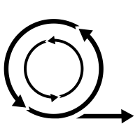


ISG Guiding Principles
Open Source
Highly Collaborative
Interactive
Easy to use
Data Standard Compliant
Agile
Engaging
Notes:
Open Source - Transparent. Customizable. Free!
Highly Collaborative - Clinicians and Programmers working together.
Interactive - Users can explore their data.
Easy to Use - Just open up a webpage.
Easy to Configure - Streamlined configuration with R.
Compliant with Data Standards - Support ADaM and SDTM by default.
Agile - Frequent releases with GitHub.
Engaging - Regular Feedback from users. Pilot testing. Open issue tracking.

Slide 7





Medical Monitoring
Data Exploration
Data Monitoring Committee
Risk-Based Monitoring?
Regulatory Submissions??
Notes:
Medical Monitoring
Data Exploration – Supplemental tool for analysts.
Data Monitoring Committee - Novartis submitted graphics to DMC.
Risk-based Monitoring?
Regulatory Submissions???
Lots of discussion here. Several other working groups piloting interactive submissions.

Slide 8
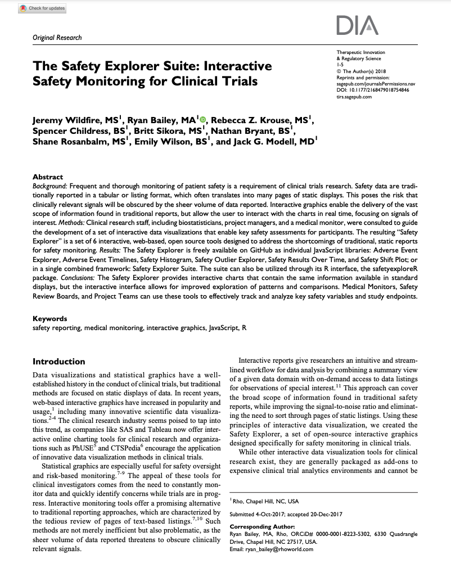
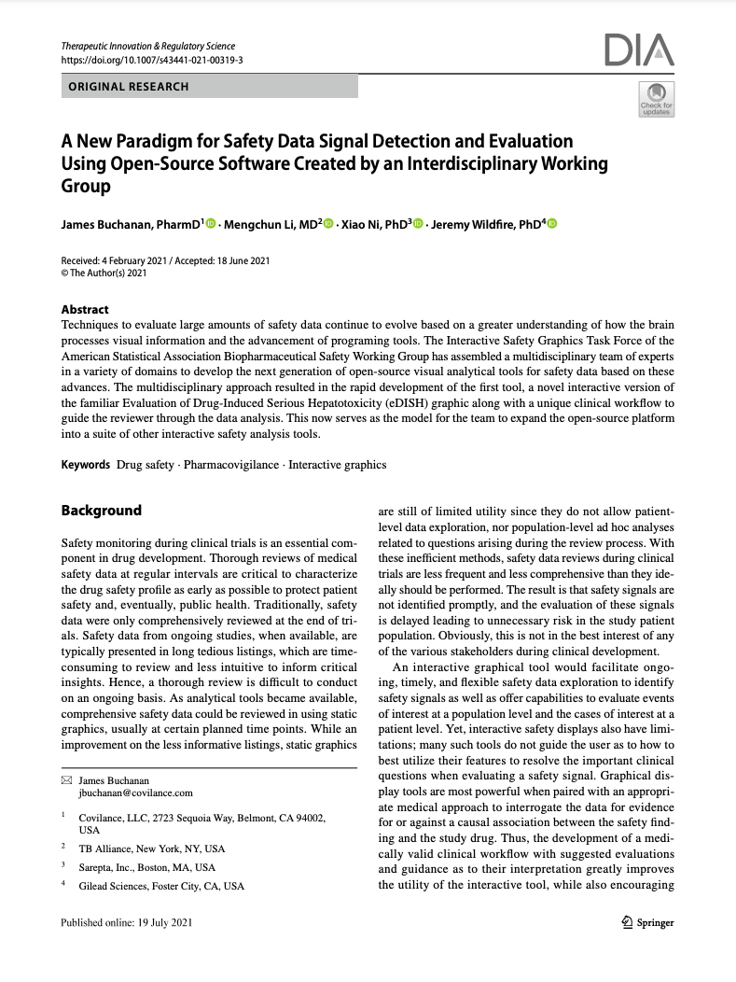
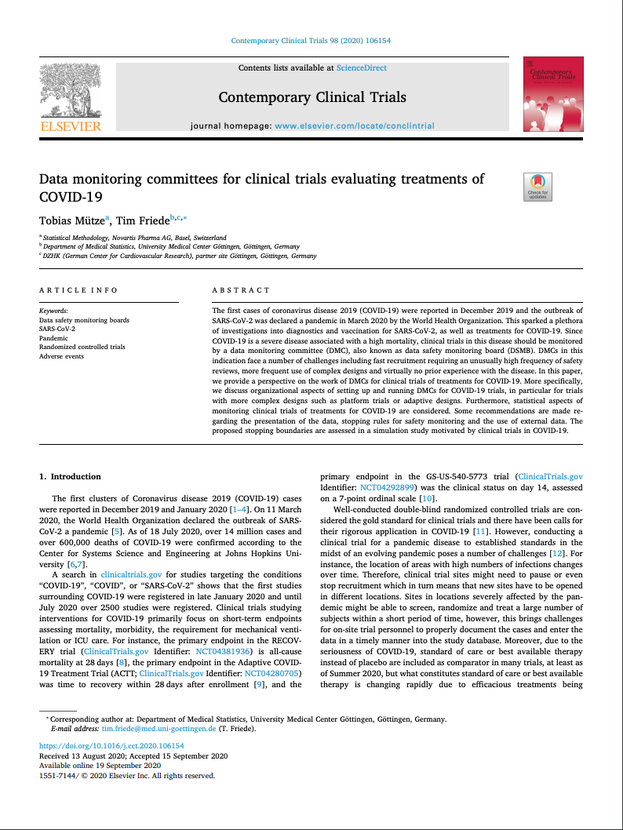
The Safety Explorer Suite: Interactive Safety Monitoring for Clinical Trials, Wildfire et al. 2018
Paper - Repo
A New Paradigm for Safety Signal Detection and Evaluation Using Open-Source Software Created by an Interdisciplinary Working Group. 2021 Buchanan
Paper – Repo
Data Monitoring committees for clinical trials evaluating treatments of COVID-19. Tobias Mütze and Tim Friede. 2020 - Paper

Slide 9
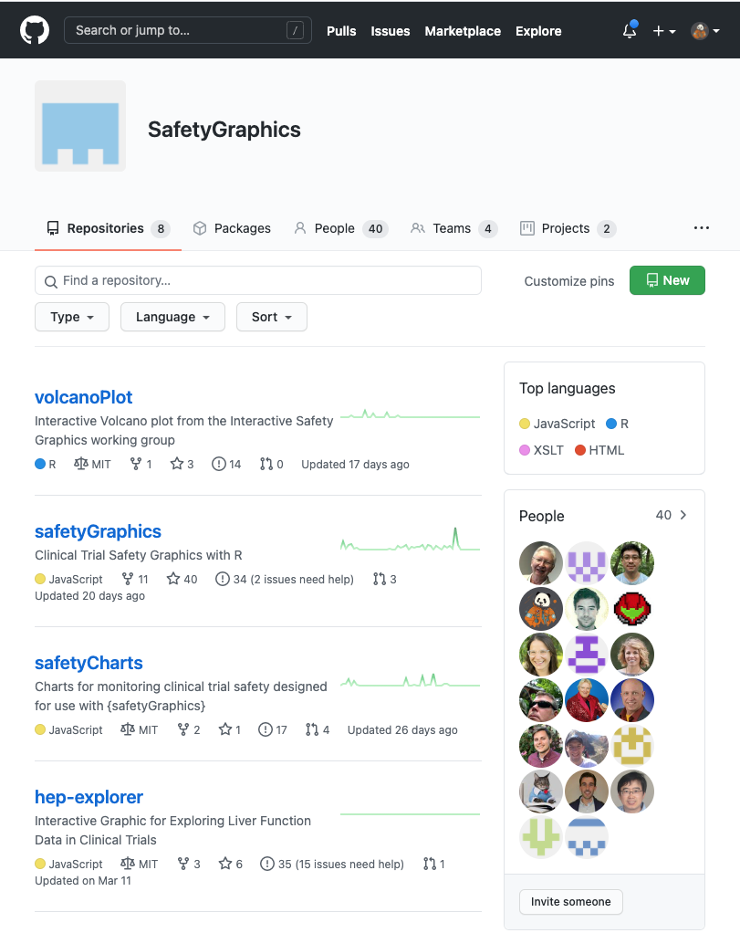
Open and Transparent Online Collaboration
We use a public GitHub site for:
Source Code Storage
Version Control
Testing/QC infrastructure
Issue tracking
Release Tracking
Discussion boards
Meeting Minutes
Project Management (Release Tracking, Kanban boards, etc)
Web-site hosting
https://github.com/SafetyGraphics

Slide 10
Contributor Guidelines

Slide 11
Vignettes
Intro Vignette - Introductory vignette providing the overview of the package.
Chart Configuration Vignette - Details about the charting process including technical specifications and step-by-step instructions.
Cookbook Vignette - A series of examples showing how to initialize the safetyGraphics Shiny app in different scenarios.
Technical FAQ Vignette - Vignette discussing security, validation and other technical issues.
Link: https://github.com/safetygraphics/safetygraphics/wiki

Slide 12
Package Ecosystem
The {safetyGraphics} platform displays charts from {safetyCharts}.
{safetyGraphics} – Reusable Shiny App for safety monitoring
{safetyCharts} – Reusable stand-alone charts for safety monitoring
{safetyData} – sample AdAM and SDTM datasets from PhUSE used for examples and testing.

Slide 13
02. Hello World
Run the app with default data, or load data and select charts with a simple GUI

Slide 14
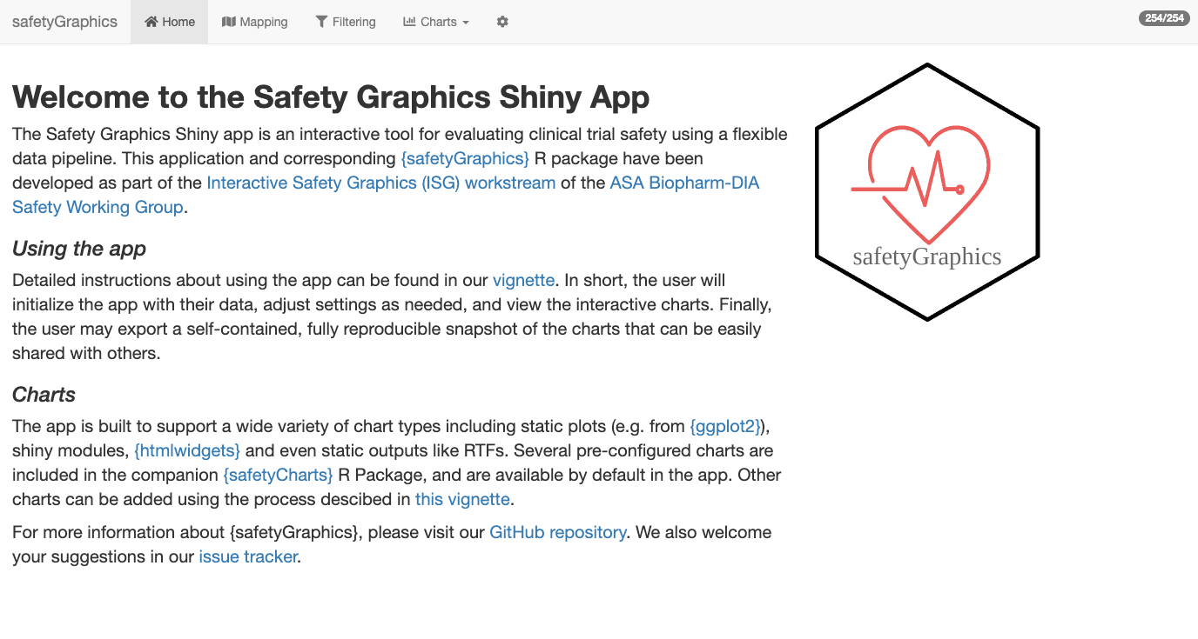
Hello World
install.packages('safetyGraphics’)
library(safetyGraphics)
safetyGraphicsApp()

Slide 15
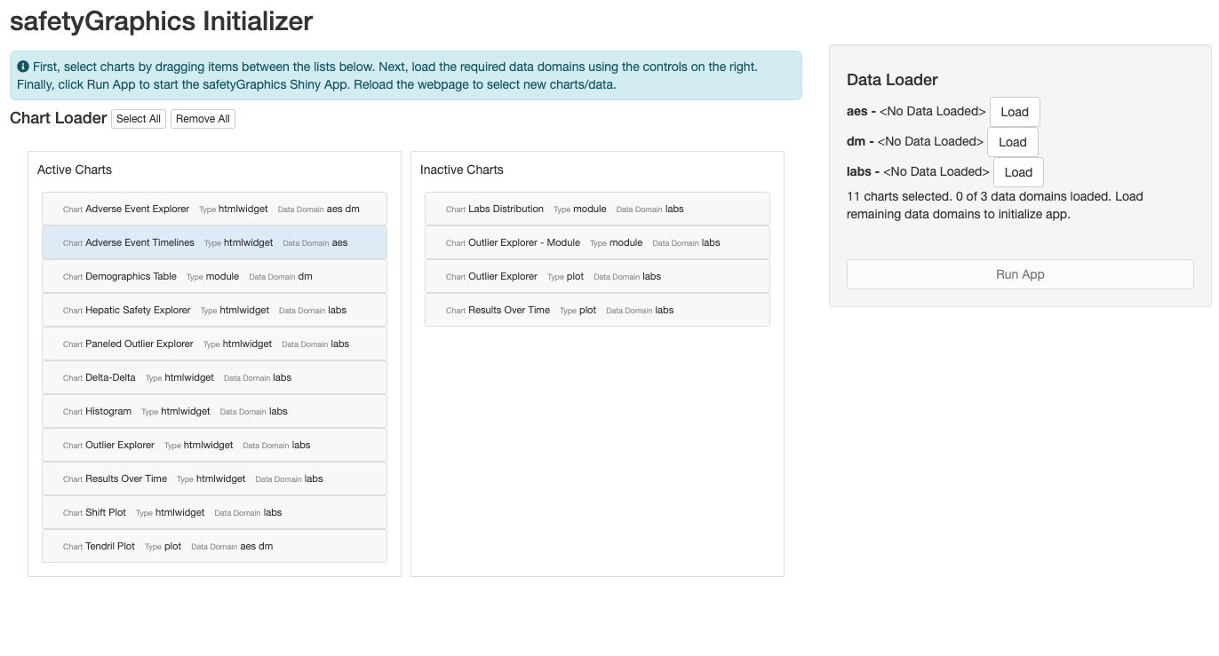
Hello World, Again
install.packages('safetyGraphics’)
library(safetyGraphics)
safetyGraphicsInit()

Slide 16
03. Loading Custom Data
Create a reusable R script to load your own data and save a data mapping.

Slide 17
Configurable App Inputs
Data – Study data provided by the user as a named list.
Mapping – List identifying the key columns/fields in your data.
Charts – Default library in safetyCharts. See Chart Configuration Vignette
Meta – Metadata table with information about key data columns/fields used in charts. Saved as `safetyGraphics::meta`

Slide 18
?safetyGraphicsApp docs
safetyGraphicsApp(
domainData = list(
labs = safetyData::adam_adlbc,
aes = safetyData::adam_adae,
dm = safetyData::adam_adsl
),
meta = safetyGraphics::meta,
charts = NULL,
mapping = NULL,
autoMapping = TRUE,
filterDomain = "dm",
chartSettingsPaths = NULL
)
domainData | named list of data.frames to be loaded into the app. Sample AdAM data from the safetyData package used by default
charts | list of charts in the format produced by safetyGraphics::makeChartConfig()
mapping | list specifying the initial mapping values for each data mapping for each domain (e.g. list(aes= list(id_col='USUBJID', seq_col='AESEQ')).
autoMapping | boolean indicating whether the app should attempt to automatically detect data standards and generate mappings for the data provided. Values specified in the mapping parameter overwrite automatically generated mappings when both are found. Defaults to true.
meta | data frame containing the metadata for use in the app. See the preloaded file (?safetyGraphics::meta) for more data specifications and details. Defaults to safetyGraphics::meta.
filterDomain | domain used for the data/filter tab. Demographics ("dm") is used by default. Using a domain that is not one record per participant is not recommended.
chartSettingsPaths | path(s) where customization functions are saved relative to your working directory. All charts can have initialization (e.g. myChart_Init.R) and static charts can have charting functions (e.g. myGraphic_Chart.R). All R files in this folder are sourced and files with the correct naming convention are linked to the chart. See the Custom Charts vignette for more details.

Slide 19



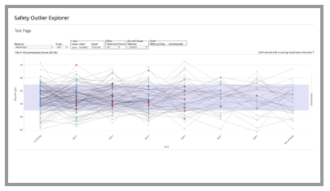
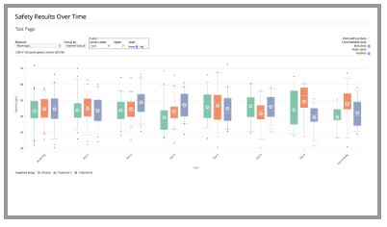
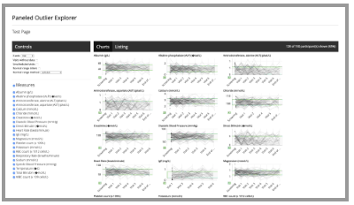
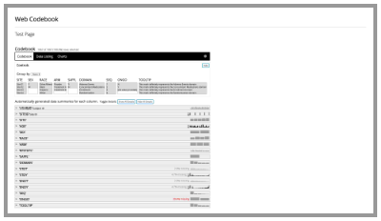

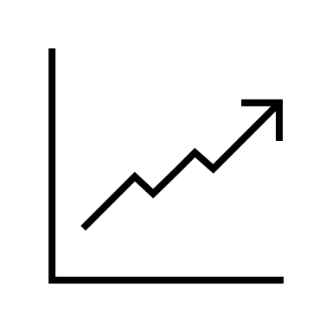

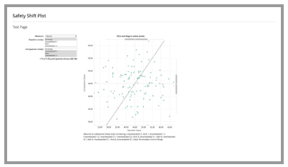
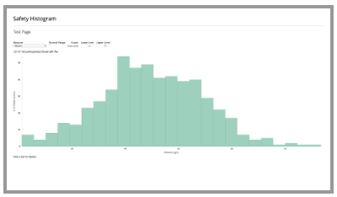

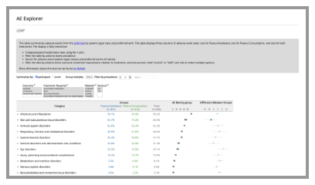
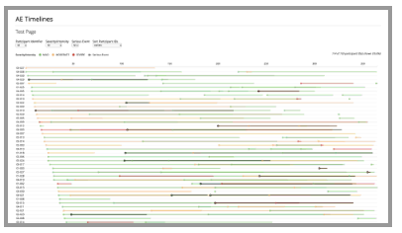


Domain Data
Interactive Graphics
Charts
Metadata + Mapping

Slide 20
04. App/Chart Export
Export Code to reproduce the whole app or individual charts

Slide 21
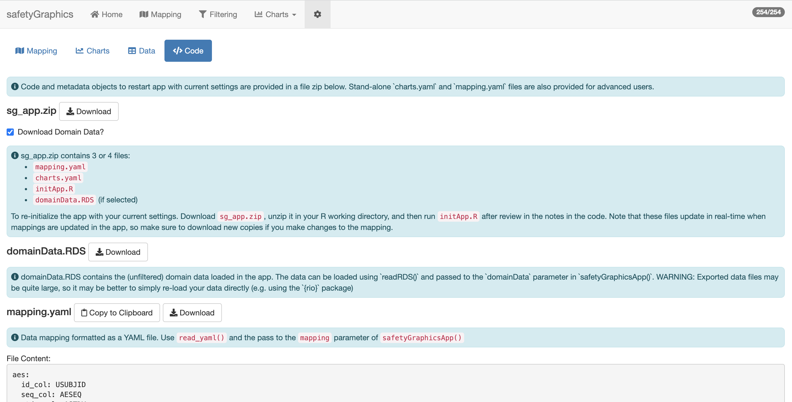
App Export
https://github.com/SafetyGraphics/safetyGraphics/wiki/ChartConfiguration

Slide 22
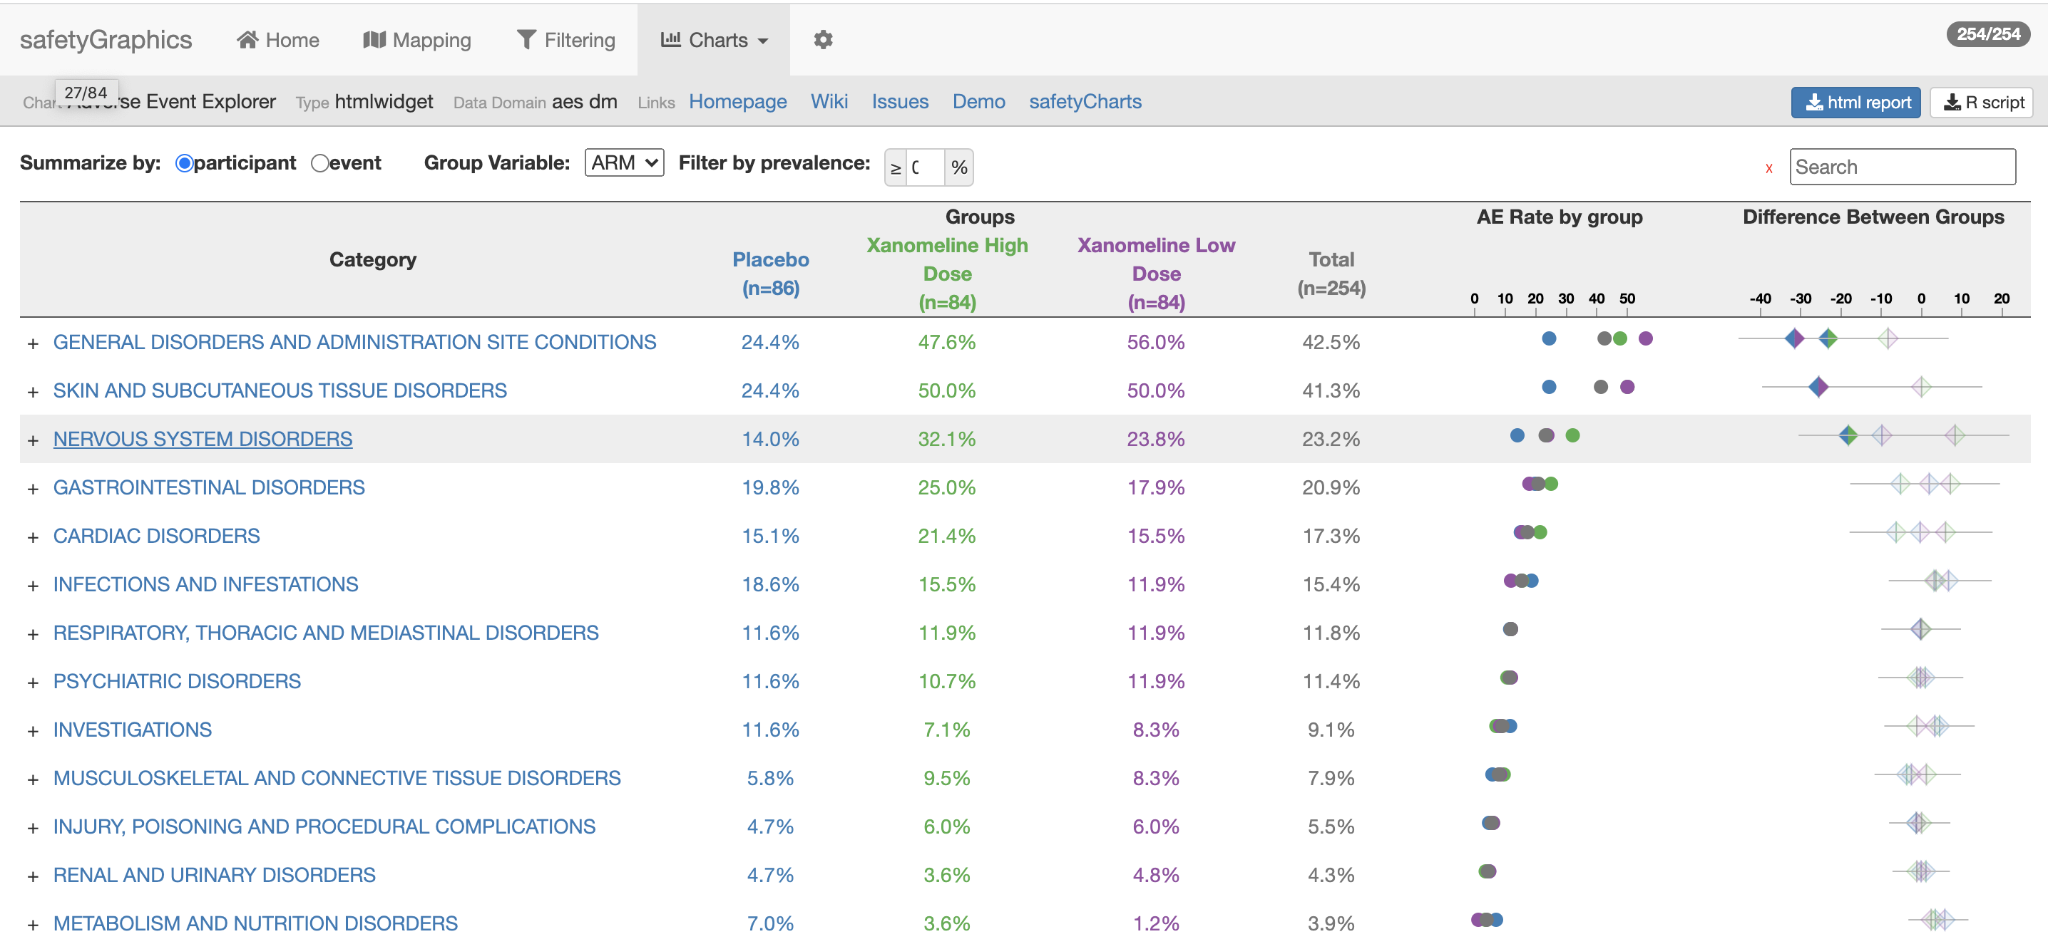
Chart Export

Slide 23
04. Customizing Charts
Select from existing charts in the safetyCharts package or add your own!

Slide 24
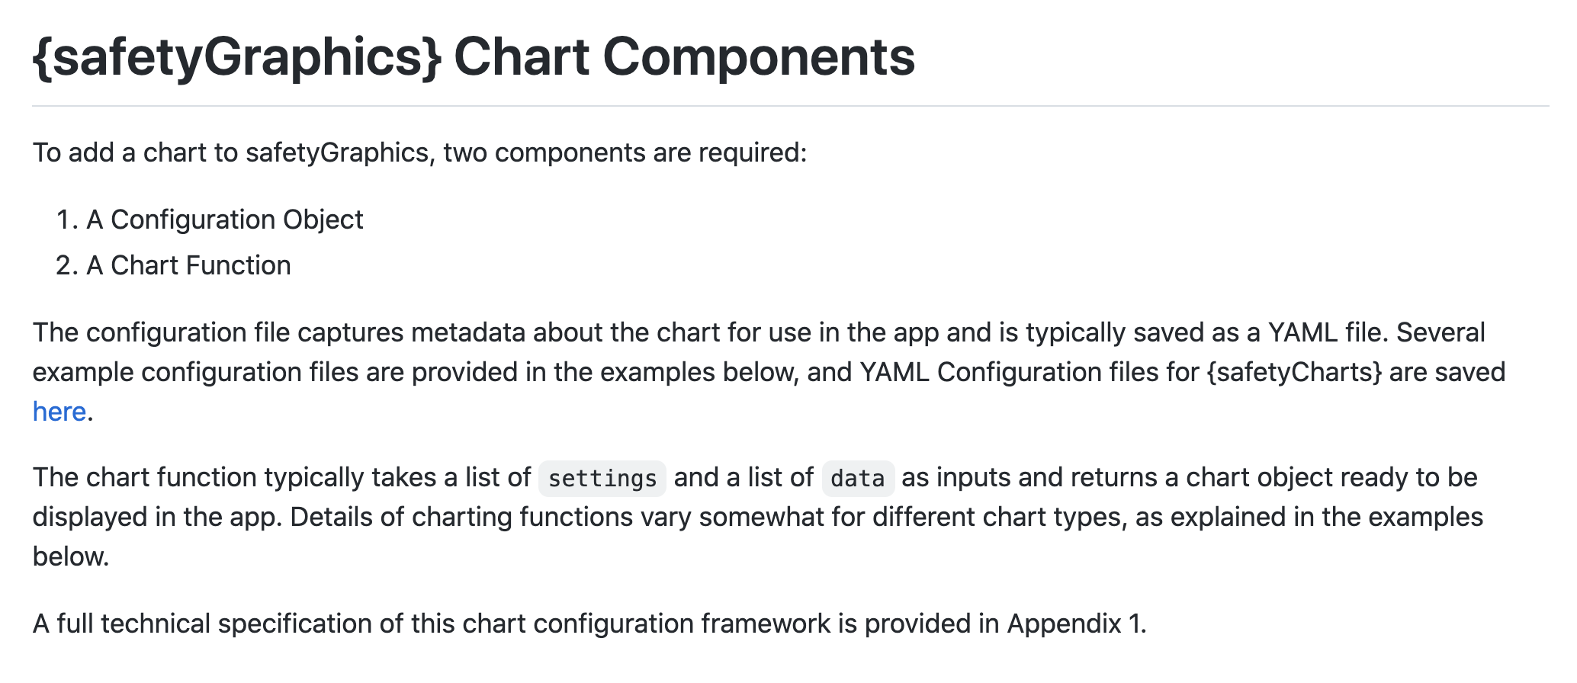
https://github.com/SafetyGraphics/safetyGraphics/wiki/ChartConfiguration

Slide 25
Hello World
Chart Function
Chart config
helloWorld <- function(data, settings){
plot(-1:1, -1:1)
text(
runif(20, -1,1),
runif(20, -1,1),
"Hello World”
)
}
helloworld_chart<-list(
env="safetyGraphics",
name="HelloWorld",
label="Hello World!",
type="plot",
domain="aes",
workflow=list(
main="helloWorld"
)
)
Run App
> safetyGraphicsApp(charts=list(helloworld_chart))

Slide 26
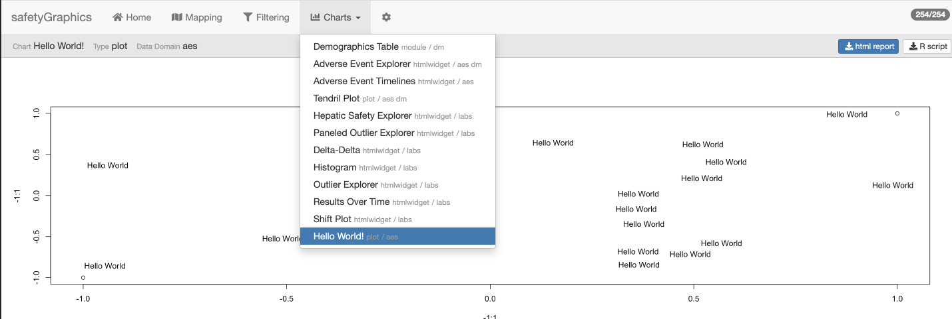

Slide 27
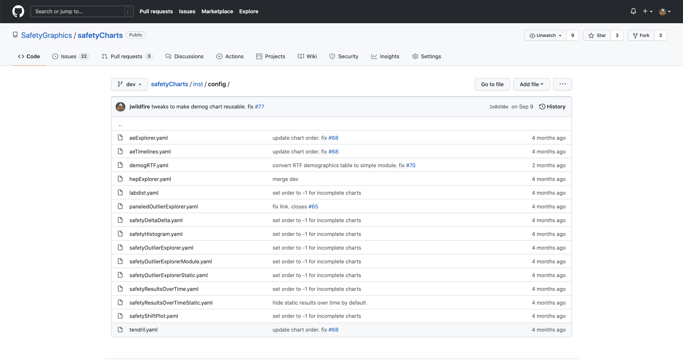
Default Charts from safetyCharts

Slide 28
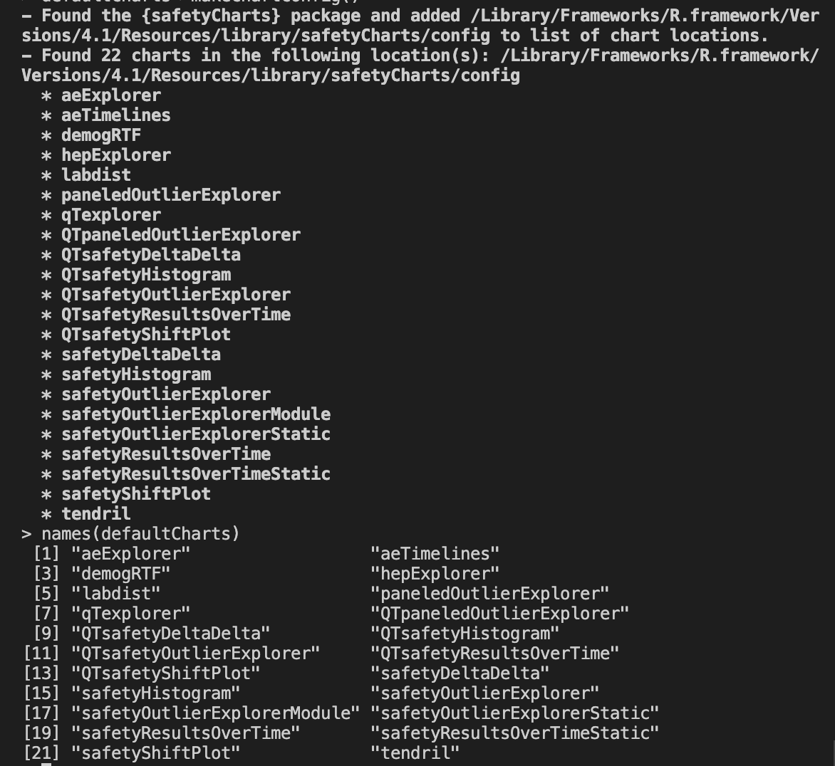
> # load charts from safetyCharts
> defaultCharts <- safetyGraphics::makeChartConfig()

Slide 29
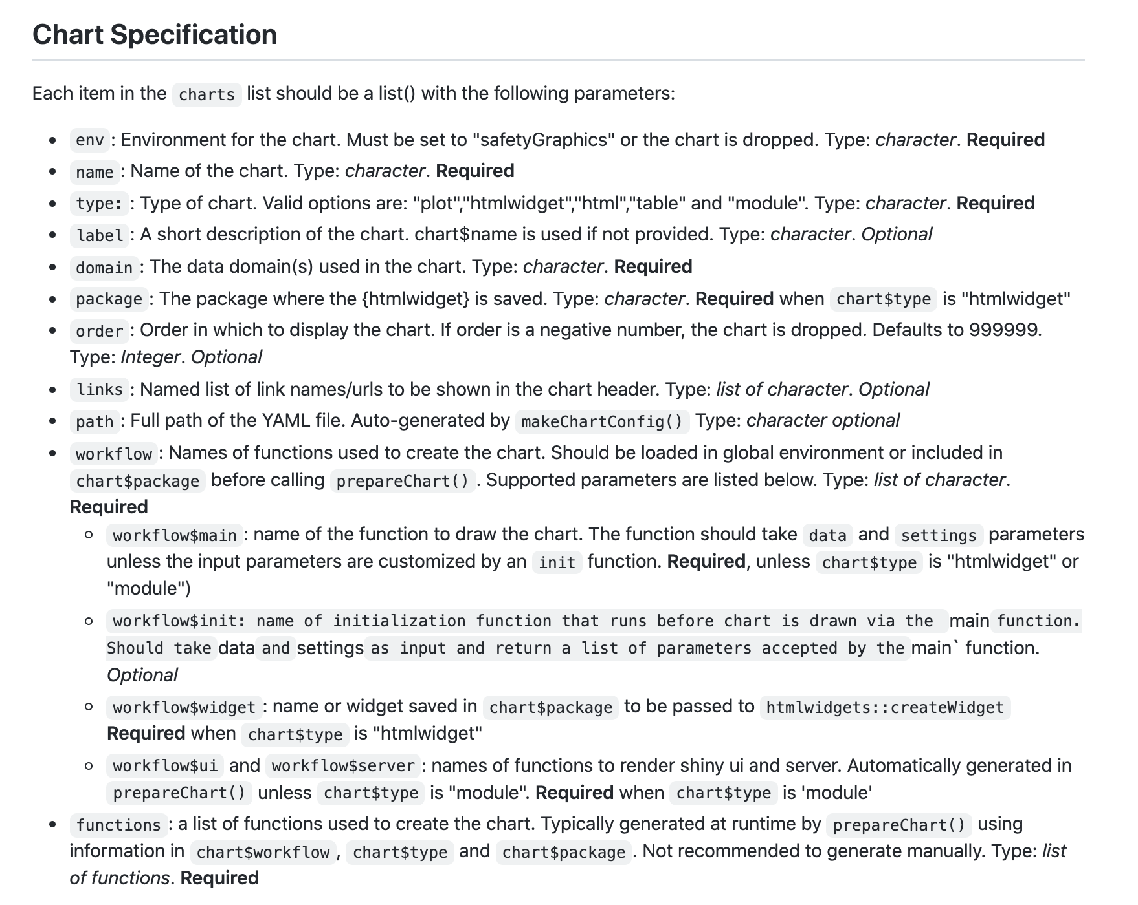
Link to wiki

Slide 30
Shiny App
# Start safetyGraphics Shiny App with custom charts
safetyGraphicsApp(charts=myCharts)
myCharts list()
# Make list of all charts in specific location
# Specify ‘path’ or ‘package’ - ‘safetyCharts’ = default
myCharts<-makeChartConfig()
aeExplorer
list(…)
outlierModule
list(…)
…
newChart
list(…)
myCharts$newChart list()
name
‘newChart’
domain
‘labs’
type
‘htmlwidget’
# Add a Single Chart (usually saved as yaml)
# Automatically called for yaml in ‘path’/‘package’
myCharts$newChart<-read_yaml(path)
workflow
list(…)
functions
list(…)
myCharts$newChart$functions list()
# Bind list of functions to a chart
# Specified by chart$workflow, chart$type & chart$package
# Automatically called for yaml in ‘path’/‘package’
myCharts$newChart<-prepareChart(myCharts$newChart)
ui
function()
server
function()
init
function()
main
function(data, settings)
data
list(df1,df2,…)
settings
list(list1,list2,…)
# Data and Setting inputs used in main() and init()
# reactive() in shiny app, but not in exported code.

Slide 31
04. Adding Custom Domains
Customize `metadata` to add data domains to the app, and then create charts using the data!

Slide 32
Adding New Data Domains with `meta`
Data – Study data provided by the user as a named list.
Mapping – List identifying the key columns/fields in your data.
Charts – Default library in safetyCharts. See Chart Configuration Vignette
Meta – Metadata table with information about key data columns/fields used in charts. Saved as `safetyGraphics::meta`
Determines which data domains are included in the app
Populates mapping tab in shiny app
`labs`, `dm` and `aes` domains included by default
New domains are added when found in `meta`

Slide 33
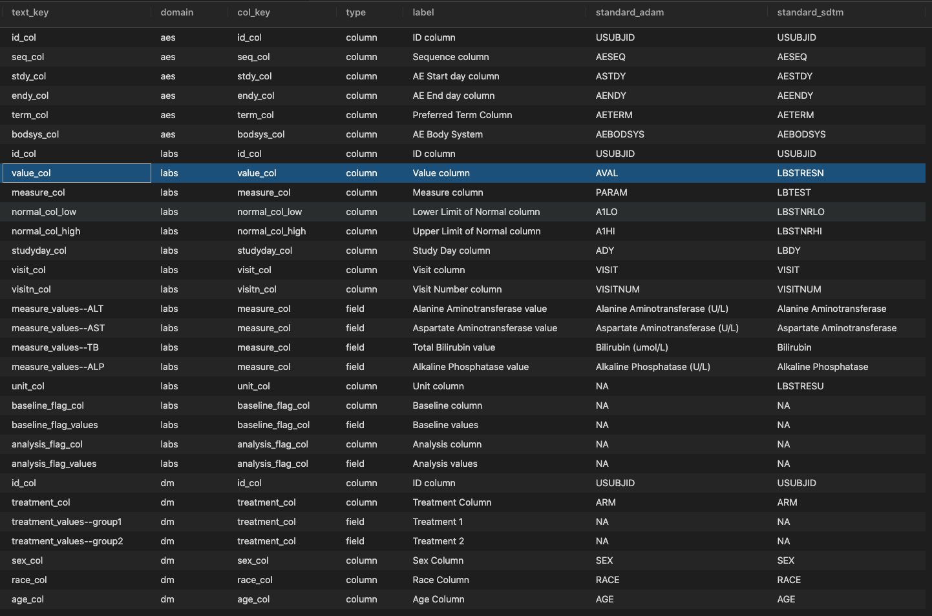
Default Metadata

Slide 34
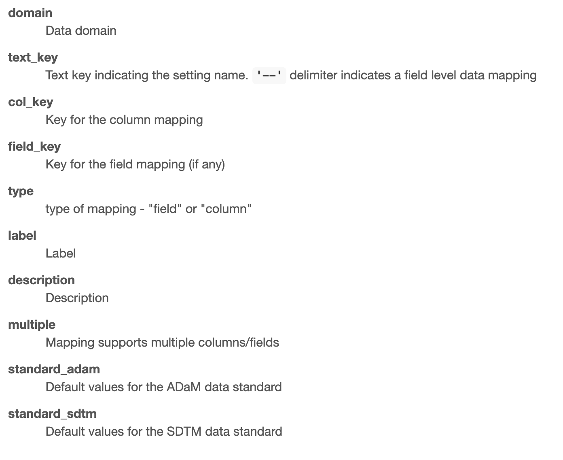
?safetyGraphics::meta Metadata Column Definitions

Slide 35
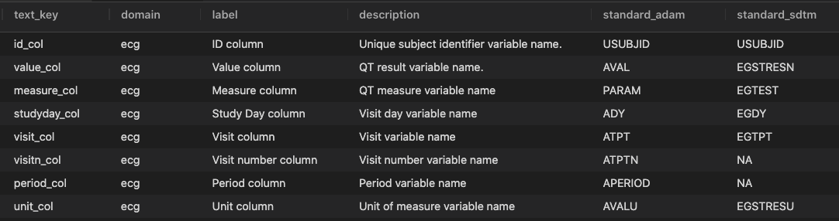
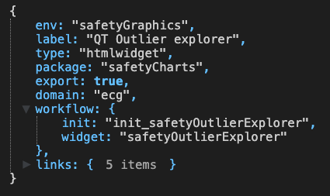
Creating a Chart in a Custom Domains
1
Create metadata for new domain
safetyGraphicsApp(
meta=ecg_meta,
charts=ecg_chart,
domainData=list(ecg=adeg)
)
1
2
3
2
Define a chart using the new domain
3
Load data for the new domain
adeg <- readr::read_csv("https://physionet.org/files/ecgcipa/1.0.0/adeg.csv?download")

Slide 36
Appendix – Shiny Modules

Slide 37
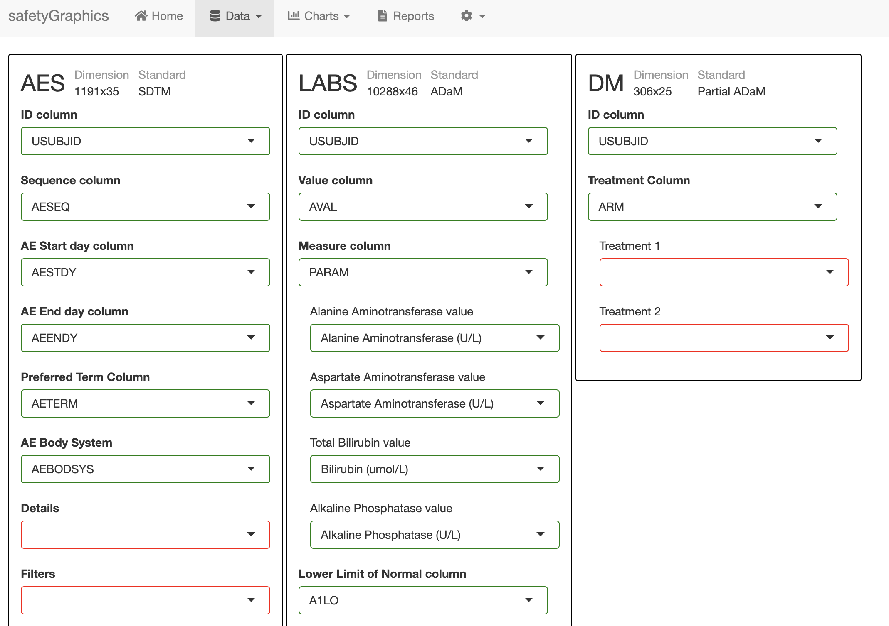
safetyGraphics 2.0 Multiple Data Domains
1 Mapping Tab Module

Slide 38
safetyGraphics 2.0 Multiple Data Domains
3 Domain Modules

Slide 39
safetyGraphics 2.0 Multiple Data Domains
14 Column Modules

Slide 40
safetyGraphics 2.0 Multiple Data Domains
20 Select Modules

